Slide 1



文献汇报
Multispectral human co-segmentation via joint convolutional neural networks

Slide 2




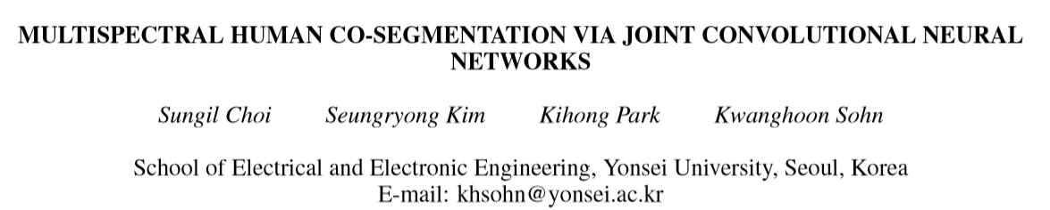
Conference: 2017 IEEE International Conference on Image Processing (ICIP)
Year: 2017, Page 3115 DOI: 10.1109/ICIP.2017.8296856

Slide 3
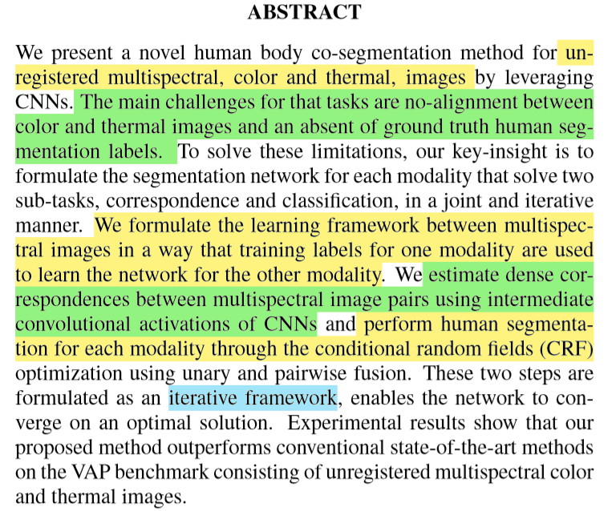
配准和分类
使用一种模态的训练标签来学习另一种模态的网络
使用CNN的中间卷积来估计多光谱图像之间的密集对应
通过一元和二元融合的CRF优化人体分割

Slide 4
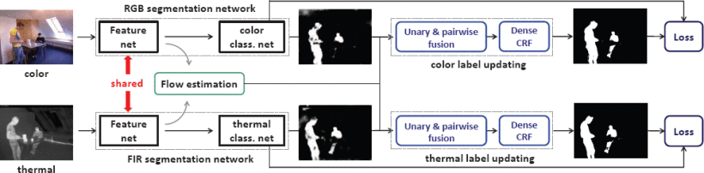
FCN，最终的卷积层被修改为具有2个类
Fig. 2.Overview of our framework, consists of three key-pipelines, color and thermal human segmentation networks, flow estimation, CRF opitimization with the fusion of color and thermal information.

Slide 5
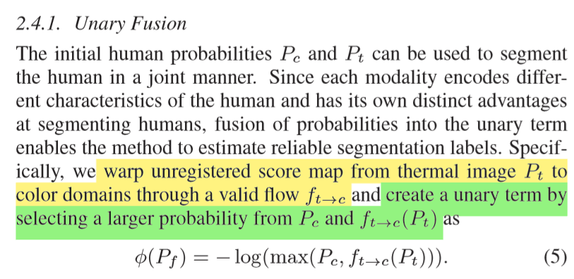

Slide 6
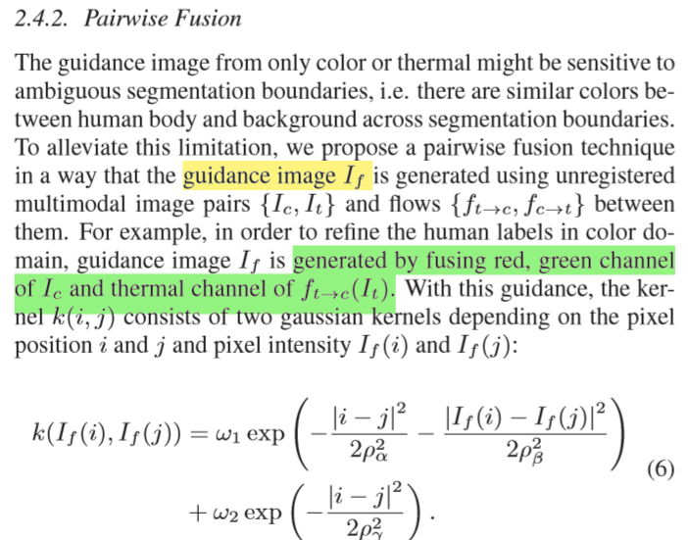

Slide 7
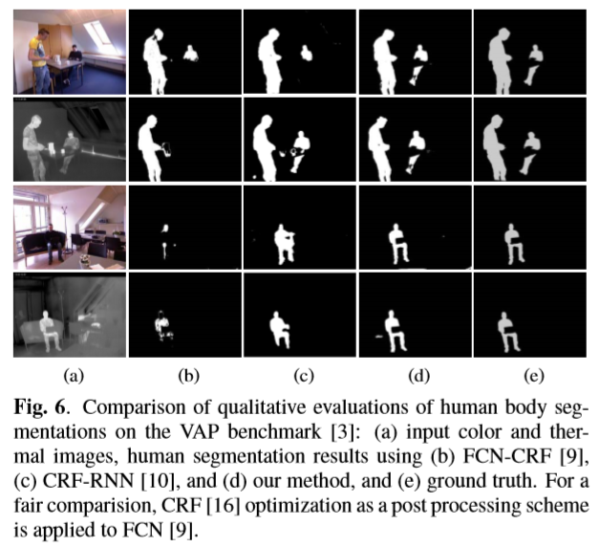

Slide 8


实验分析
ConvCRFs

Slide 9
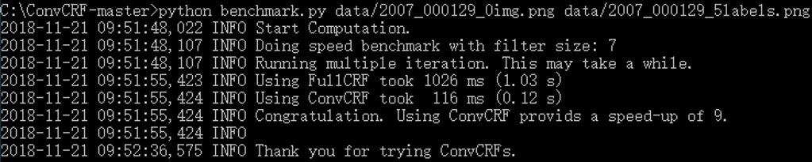
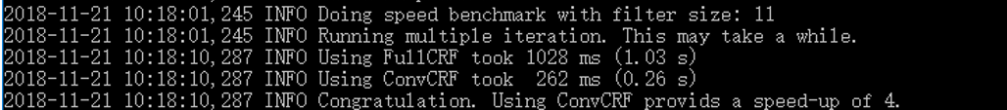
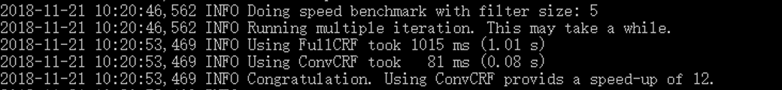

Slide 10
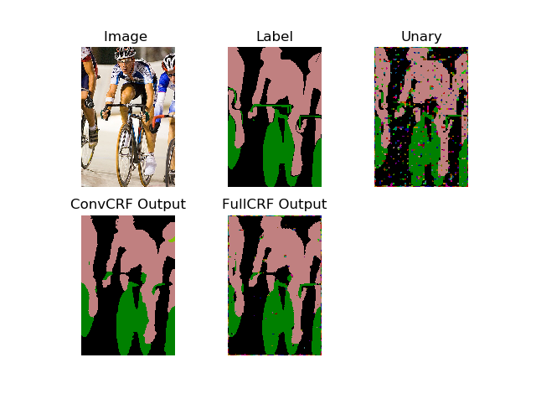


Slide 11
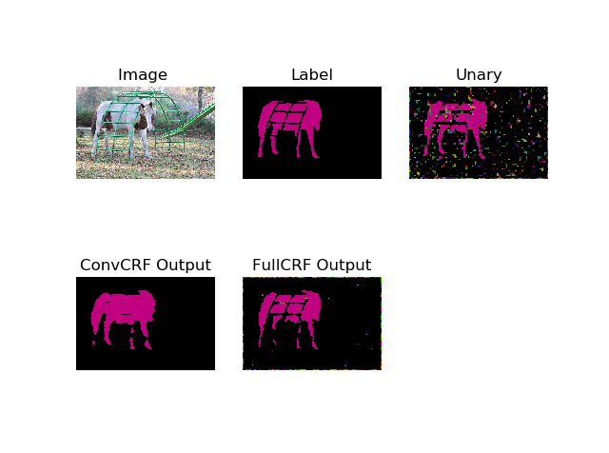


Filter Size -5
Filter Size -7
Filter Size -11

Slide 12


汇报人：康萌萌

